Slide 1
Operating System Lec-02 Process Abstraction
Tahira Alam
University of Asia Pacific

Slide 2
OS manages CPU
OS provides the process abstraction
– Process: a running program
– OS creates and manages processes
• Each process has the illusion of
having the complete CPU, i.e., OS
virtualizes CPU
• Timeshares CPU between processes
• Enables coordination between
processes
P1
P2
P3
CPU

Slide 3
OS manages memory
Memory
Of a Process
OS manages the memory
of the process: code, data,
stack, heap etc
• Each process thinks it has a
dedicated memory space
for itself, numbers code
and data starting from 0
(virtual addresses)
• OS abstracts out the details
of the actual placement in
memory, translates from
virtual addresses to actual
physical addresses
0
1
2
.
.
.
.
.
n
Code
Data
RAM
Stack
Heap

Slide 4
OS provides process abstraction
When you run an exe file, the OS creates a
process = a running program
• OS timeshares CPU across multiple processes:
virtualizes CPU
• OS has a CPU scheduler that picks one of the
many active processes to execute on a CPU
– Policy: which process to run
– Mechanism: how to “context switch” between
processes

Slide 5
What constitutes a process?
Memory Image
Of a Process
A unique identifier (PID)
• Memory image
– Code & data (static)
– Stack and heap (dynamic)
• CPU context: registers
– Program counter
– Current operands
– Stack pointer
• File descriptors
– Pointers to open files and
devices
CPU Context
PC
Code
Data
Reg.
Stack
Reg.
Heap
SP

Slide 6
How does OS create a process?
Memory
Allocates memory
and creates memory
image
– Loads code, data
from disk exe
– Creates runtime
stack, heap
• Opens basic files
– STD IN, OUT, ERR
• Initializes CPU
registers
– PC points to first
instruction
CPU
Code
Data
PC
Exe
file

Slide 7
States of a process(1)
Running: currently executing on CPU
• Ready: waiting to be scheduled
• Blocked: suspended, not ready to run
– Why? Waiting for some event, e.g., process issues a read from disk
– When is it unblocked? Disk issues an interrupt
when data is ready

Slide 8
States of a process(2)
New: being created, yet to run
Dead: terminated

Slide 9
Process State Transitions
De-Scheduled
Running
Ready
Scheduled
I/O Initiate
Blocked
I/O done

Slide 10
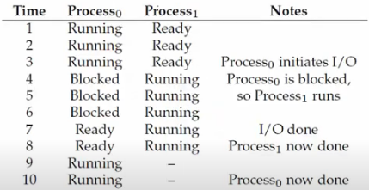
Example: Process States

Slide 11
OS data structures
OS maintains a data structure (e.g., list) of all
active processes
Information about each process is stored in a
process control block (PCB)
– Process identifier
– Process state
– Pointers to other related processes (parent)
– CPU context of the process (saved when the process is
suspended)
– Pointers to memory locations
– Pointers to open files

Slide 12
Multiprocessors
Multiprocessing is the use of two or more central processing units within a single computer system.
Symmetric Multiprocessing
Asymmetric Multiprocessing

Slide 13
Asymmetric Multiprocessing
not all of the multiple interconnected central processing units (CPUs) are treated equally.
only a master processor runs the tasks of the operating system

Slide 14
Symmetric Multiprocessing(1)
two or more identical processors are connected to a single, shared main memory, have full access to all input and output devices

Slide 15
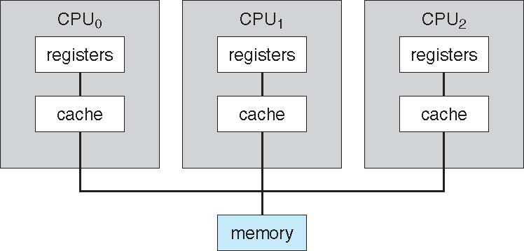
Symmetric Multiprocessing(2)

Slide 16
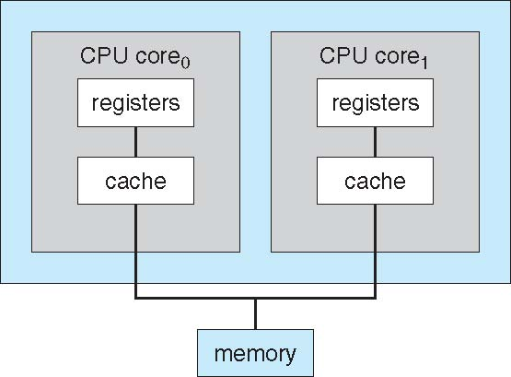
Symmetric Multiprocessing(3)

Slide 17
Cluster Systems
Like multiprocessor systems, but multiple systems working together
Usually sharing storage via a storage-area network (SAN)
Provides a high-availability service which survives failures
Asymmetric clustering has one machine in hot-standby mode
Symmetric clustering has multiple nodes running applications, monitoring each other

Slide 18
Computing Environments(1)
Traditional computer
Blurring over time
Office environment
PCs connected to a network, terminals attached to mainframe or minicomputers providing batch and timesharing
Now portals allowing networked and remote systems access to same resources
Home networks
Used to be single system, then modems
Now firewalled, networked

Slide 19
Computing Environments(2)
Client-Server Computing
Dumb terminals supplanted by smart PCs
Many systems now servers, responding to requests generated by clients
Compute-server provides an interface to client to request services (i.e., database)
File-server provides interface for clients to store and retrieve files

Slide 20
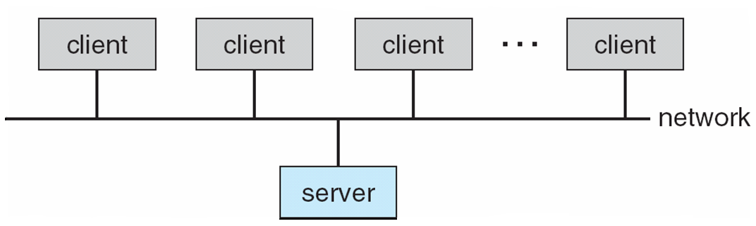
Computing Environments(3)
Client-Server Computing

Slide 21
Computing Environments(4)
Peer to Peer
P2P does not distinguish clients and servers
Instead all nodes are considered peers
May each act as client, server or both
Node must join P2P network

Slide 22
Computing Environments(4)
Web based Computing
Web has become ubiquitous
PCs most prevalent devices
More devices becoming networked to allow web access
New category of devices to manage web traffic among similar servers: load balancers

Slide 23
Protection and Security
Protection – any mechanism for controlling access of processes or users to resources defined by the OS.
Security – defense of the system against internal and external attacks.

Slide 24
Thank You!

